Slide 2
WAS PETER
A
POPE?
Matthew 16:13-19

Slide 3
"Keys" Connected to "Binding & Loosing" Authority - Shared with Other Apostles -
Matthew 16:19 “And I will give you the keys of the kingdom of heaven, and whatever you bind on earth will be bound in heaven, and whatever you loose on earth will be loosed in heaven.”
Matthew 18:18 NKJV 18 "Assuredly, I say to you, whatever you bind on earth will be bound in heaven, and whatever you loose on earth will be loosed in heaven.”

Slide 4
THE CHURCH WAS BUILT ON PETER
Two Of The Supposed “Church Fathers” Did Not Believe This
“Having said that his confession is a rock, he stated that upon this rock I will build my church. This means he will build his church upon this same confession and faith.” Theodore of Mopsuestia (350 – 428 AD)
. "And I say unto thee, Thou art Peter, and upon this rock will I build my Church;" that is, on the faith of his confession."- John Chrysostom (?- 407 AD)

Slide 5
Catholics Believe Church Is Built On Peter
Matthew 16:18 "Kagoo de soi legoo hoti su ei Petros, kai epi tautee tee petra oikodomeesoo mou teen ekkleesian, kai pulai Hadou ou katischusousin autees.“
Petros - "a detached stone or boulder, or a stone that might be thrown or easily moved."
Petra - "denotes a mass of rock, as distinct from Petros"

Slide 6

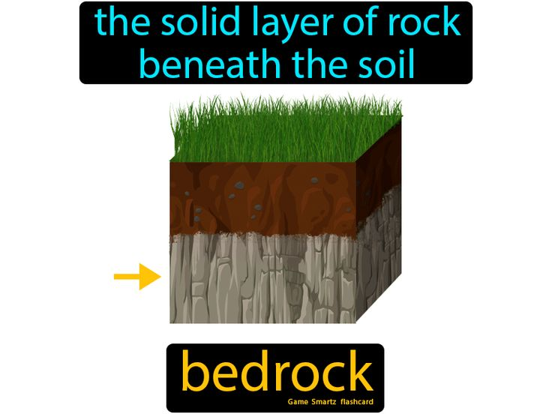
The Difference is
Important!
Petros - "a detached stone or boulder, or a stone that might be thrown or easily moved."
Petra - "denotes a mass of rock, as distinct from Petros"

Slide 7
No Similarities Between Peter & Pope:
Holy Sacrifice of the Mass, pp 282,283 “Virginal chastity is the most precious pearl, the brightest jewel in the crown of sacerdotal virtues. Nothing equals in value and dignity a pure soul resplendent with the brilliance of chastity...It is for a virginally pure priesthood to offer the all-pure sacrifice of the virginal body of Christ."
Catholic Encyclopedia "Reference to the virgin state....often met with in Christian inscriptions; from the fourth century on mention is made of virginity especially dedicated to God." (Vol. III, p.240)

Slide 8
No Similarities Between Pope & Peter:
Celibate Pope - Cath. Ency. Vol. 3; Council of Trent, 1545, Canon 10
☞ Peter Married Man- Mark 1:30 “But Simon's wife's mother lay sick with a fever,”
1 Corinthians 9:5 “Do we have no right to take along a believing wife, as do also the other apostles, the brothers of the Lord, and Cephas?”
Homage & Praise to Pope- Cath. Ency. Vol. 12, p.270 “kissing of the pope's foot”
☞ Peter Refused Homage- Acts 10:25,26

Slide 9
No Similarities Between Pope & Peter:
Call People “Roman Catholics”- From Nicene Creed
☞ Christians Only - 1 Peter 4:16
Pope Claims Infallibility- Declared July 18, 1870
☞ Peter Claimed No Infallibility- Galatians 2:11-13 “played the hypocrite with him”

Slide 10
No Similarities Between Pope & Peter:
Pope Declared Head of Church- National Catholic Almanac, New York Catechism
☞ Christ Head of Church - Not Peter
Acts 2:29-36 “resurrection of the Christ, that His soul was not left in Hades, nor did His flesh see corruption”
Ephesians 1:22,23 “head over all things to the church”
Colossians 1:18 “all things He may have the preeminence.”

Slide 11
No Similarities Between Pope & Peter:
Pope Wears Names of Honor- Cath. Ency. Vol. 2, p.660; Vol 15, p.403
607 – Boniface III “The See of Blessed Peter”
642-649 – Theodore I - First Sovereign Pontif
1198-1216 – Innocent III “Vicar of Christ”
1277-1280 – Nicholas III “Vicar of God”
“Bishop of Rome, Vicar of Jesus Christ, Successor of Saint Peter, the Prince of the Apostles, Supreme Pontiff, Patriarch of the West, Primate of Italy, Archbishop and Metropolitan of the Roman province, and Sovereign of the State of Vatican City."

Slide 12
No Similarities Between Pope & Peter:
☞ Peter Never Wore Such Names- Matthew 23:9 “Do not call anyone on earth your father; for One is your Father, He who is in heaven.”
IF he is NOT Peter’s Successor – WHO IS HE?
2 Thessalonians 2:3,4
1Timothy 4:1-3

Slide 13
Peter Was Not A Pope
And
To Make The Claim That He Was
Is To Show Utter Disregard For
The Plain Teaching Of The
Scriptures!

